Slide 1
Creating hyperlinks with the <a> tag
Skills: using the <a> tag
IT concepts: tag, attribute
This work is licensed under a Creative Commons Attribution-Noncommercial-Share Alike 3.0 License.
Notes:
We will learn how to create HTML links using the <a> tag and its href attribute.
We will differentiate between creating links to pages on external servers and pages that are stored on the same server as the page we are creating.

Slide 2
Where does this topic fit?
Internet concepts
  Applications
  Technology
  Implications
Internet skills
  Application development (Web)
  Content creation
  User skills
Notes:
Creating hyperlinks is a Web development skill.

Slide 3
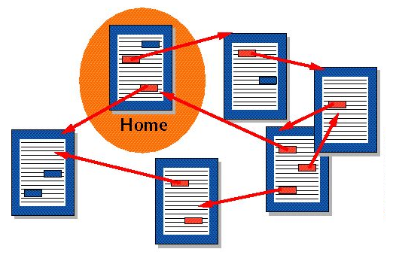
Hypertext
Hypertext:
Linear text:
Table of contents
Chapter 1 1
Chapter 2 10
Chapter 3 20
. . .
Notes:
A hypertext has embedded links, and you can jump from page to page by clicking on a link.
We can contrast that to a conventional linear text, like a book or magazine article.
A linear text is intended to be read from page one to page two and so forth to the end.
You could think of the World Wide Web as a huge hypertext with trillions of linked pages.
Let’s look at a link example and the HTML needed to create it.

Slide 4

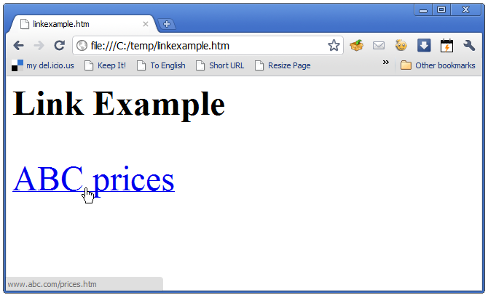
Which two things must we specify in a link?

Slide 5
Link text and target
Notes:
To create a link, you must specify two things, the link text and the destination or target.
The link text, ABC prices in this example is displayed with an underline to show that it is a link.
The destination appears in the status line at the bottom of the browser screen when the cursor rolls over the link text.
It is a page called prices.htm on a server with the domain name www.abc.com.

Slide 6
HTML for this example
<a href = “http://www.abc.com/prices”>ABC prices</a>
The link destination
The link text
Notes:
The <a> tag is used to create a link.
That may sound like a strange name to use – why not call it the tag “link” for example?
Tim Berners Lee, who invented HTML and the Web protocol, was thinking that this was the “anchor point” for the link.
The href attribute of the a tag specifies the link destination -- http://www.abc.com/prices.htm in this example.
That says we want to go to the page called “prices.htm” on the Web server with the domain name www.abc.com.
The link text is between the end of the <a> tag and the </a> which ends the link.

Slide 7
The general form
<a href = “link destination”> link text </a>
Notes:
This is the general form of the <a> tag and its href attribute, which we saw in the previous example.

Slide 8
Link to a page on a different server
<a href = “http://www.abc.com/prices”>ABC prices</a>
Notes:
When linking to a page that is on a different server, you must include the http:// followed by the domain name of the server.

Slide 9
Link to a page on your own server
<a href = “prices.htm”>ABC prices</a>
Notes:
If the link is to a page or object that is stored at your own site, you should not include the http:// and server name.
Simply give the name of the file you wish to include on your page.
If you do include http:// and the server name, it will work as long as your site remains on the same server.
But, if you ever move your Web site to another server, all of the internal links would break.

Slide 10
Link to a page on your own server
<a href = “products/prices.htm”>ABC prices</a>
Notes:
The previous example assumes that the page you are creating and the page it links to are in the same directory on the server.
If they are not, you must also include the path to the file.
In this example, the link is to a file called prices.htm which is in a sub-directory called products.

Slide 11
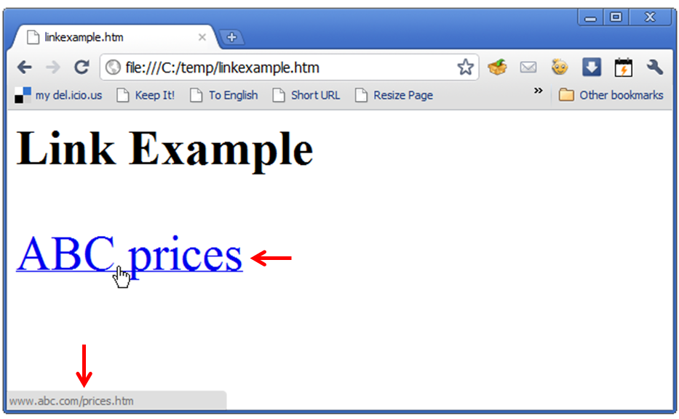
Summary
Notes:
We saw how to create links in Web pages, distinguishing between links to pages on external sites and links to pages on the same site.

Slide 12
Self-study questions
What happens if you misspell the link destination?
What happens if you misspell the link text?
What happens if you leave http:// off of an external link?
What happens if you include http:// in a local link?
Is href a tag, value, attribute or neither?
Is <a> a tag, value, attribute or neither?

Slide 13
Resource
W3schools tutorial on HTML links:
http://www.w3schools.com/html/html_links.asp

